Slide 4
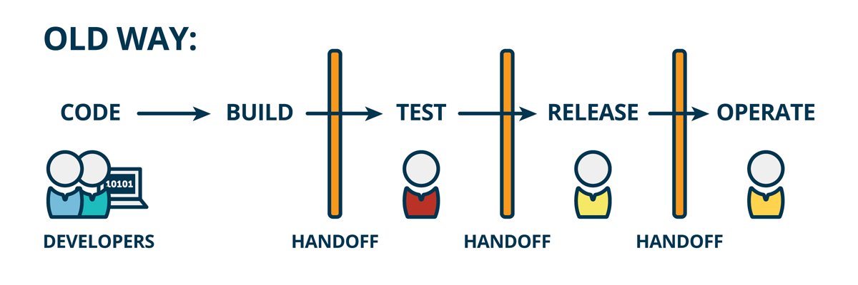
Traditional software development process
Notes:
20

Slide 5
Drawbacks
Infrequent code integration → Infrequent builds → tough debugging → More time
Less number of releases → Tested only a few times → Poor Quality
Code + {Integrate, Build, Test}
Repetitive Labor Work of Integrating, Building and Testing the code
Notes:
30

Slide 6

Continuous Integration & Continuous Deployment

Slide 7
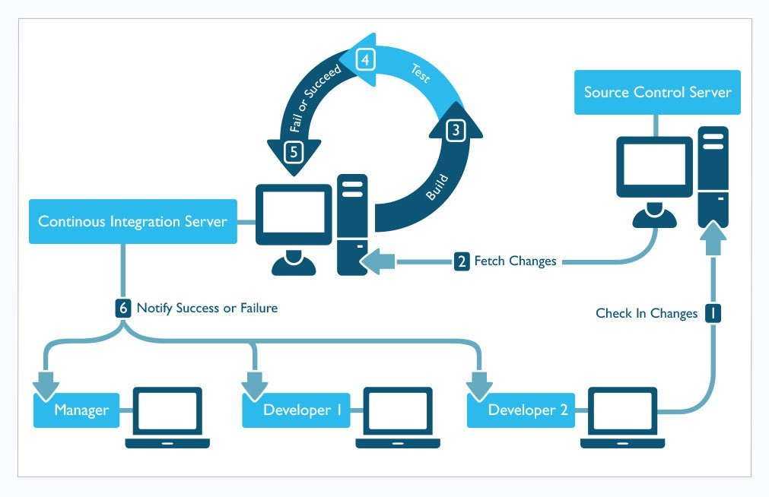
Notes:
20

Slide 8
Problems in introducing ci/cd
Inconsistencies in the development & production environment
Unnecessary increase in Man-hours leads to increase in cost -> Lack of rigorous testing-> Difficult to maintain good Quality
Lack of portability
Re-installing the same Jenkins configured environment for all projects separately
Increased Delivery time
Increased cost of constructing the infra
Notes:
40
Many a times the building and testing environment is same for different projects. But even then you need to separately install and configure things on all systems. The configurations and installations are not portable.
This increases the time to prepare the environment and repetitive efforts as well.
Also, same thing happens when you deploy the project to the production. Debvelopment to produfion porting env may differ which leads to unnecessary bug fixes a…. Difference in prod and dev enviromnt

Slide 9
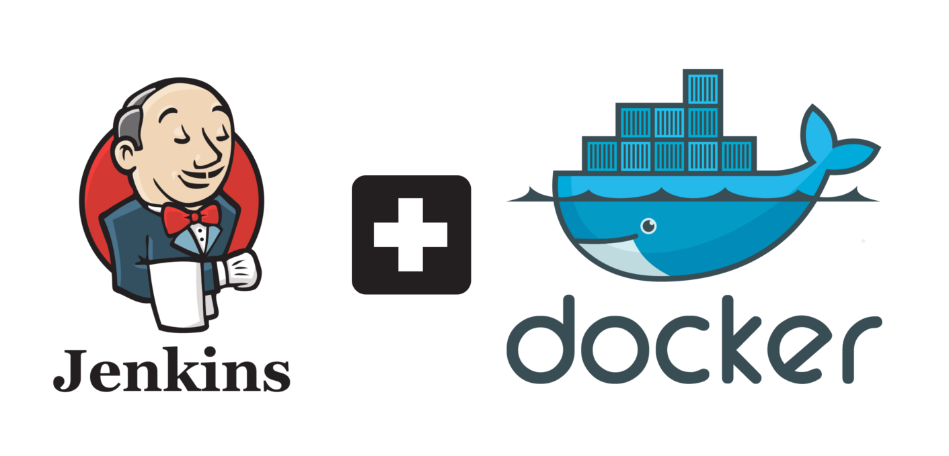
CI/CD with Docker
My mission
Notes:
5

Slide 10
My mission
Introduce CI/CD environment using DevOps
Develop a set of DevOps tools to automate the software development process with a containerized environment.
Something about containers ?
Notes:
20
What is a container : eg. Jenkins container is a running instance of jenins image. Jenkins image …. About Docker : System of container, images, Dockerfile, registry everything briefly

Slide 11
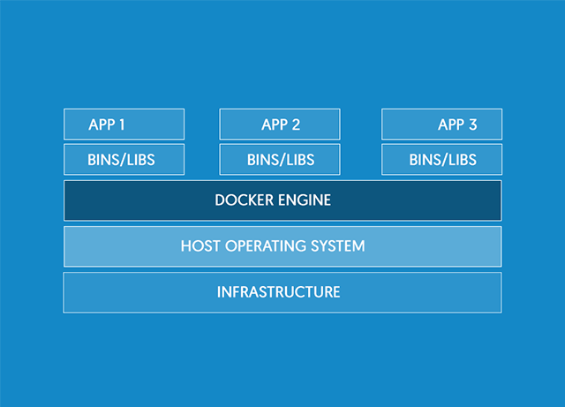
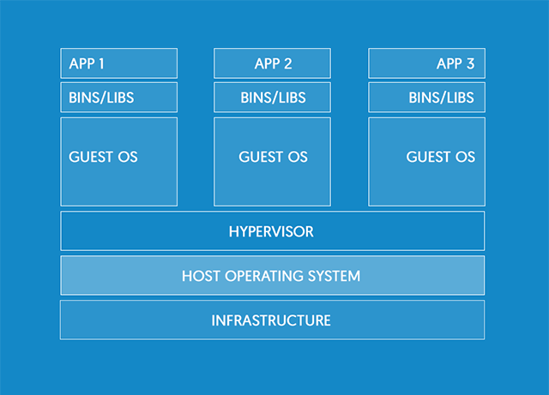
Docker Containers
Docker Container
VM
Notes:
20 Docker and container environment, difference from Vm and how its better

Slide 12
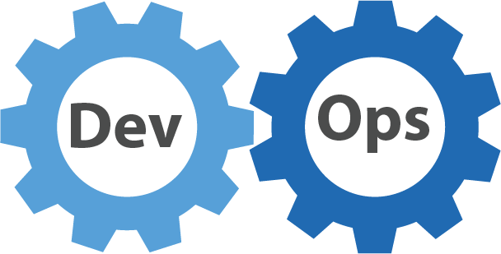
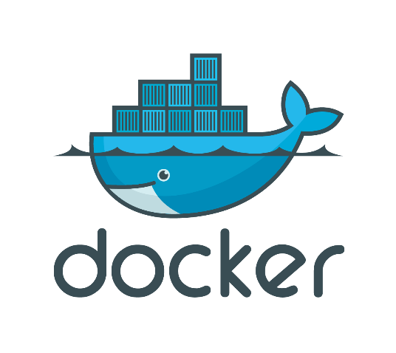
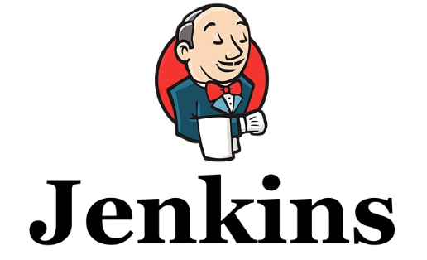


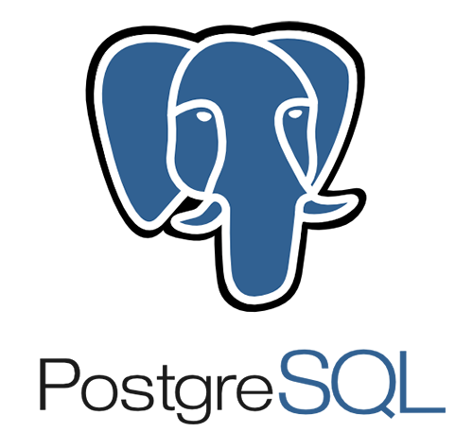

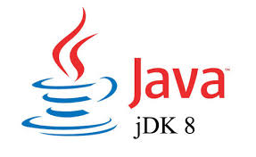
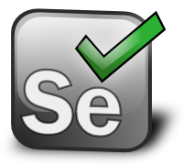
Terasoluna framework
Notes:
15
Tera is a java project, maven is the build tool, postgresql is db … I have designed this system for sample Terasoluna app using …tech stack…. I learnt these many things in the course of internship

Slide 13
System Configuration of my project

Slide 14


System Configuration
Maven
Tomcat
PostgreSQL
Selenium
Source Code Management
Linux
Linux
Linux
JENKINS CONTAINER
BUILD CONTAINER
DEPLOY & TEST CONTAINER
DOCKER ENGINE
KERNEL
Docker hub
HOST OS
Notes:
30 Jenkins inside a container and etc etc

Slide 15
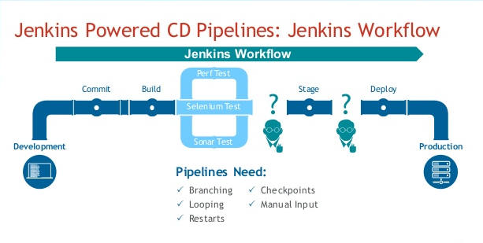
Notes:
20 Aim is to iuntrioduce this workflow using docker I have constructed conatiners for every stage : Build & Ubnit Testing, Integartion testinh

Slide 16



Work flow
Push changes to repository
Jenkins Polling
Triggers build container
Build & Unit Test
Build container
Artifacts are archived
Jenkins container
Artifacts deployed for testing
Deploy & Test
DOCKER ENGINE
Notes:
40 This is the kind of system that I have built Tell them how the entire process is divided into stages
How you made the conatiners and all

Slide 17
How did docker help ? What did you do ? Demonstration
Notes:
60 Demo

Slide 18
How my work solves the problem ?
Notes:
20 Docker features, adv of containers

Slide 19
Comparison
Task | Docker Way | Old Way | Time
Environment Preparation | Install Docker Engine | Setup VM
Launching the container | Docker pull Jenkins Launch | Install Jenkins and all its dependencies on the machine manually and configure it. Configure the build server. Setup a Jenkins agent for communication.
Notes:
40 Metric comparison with the prev way of introducing ci/cd

Slide 20
Conclusion
Time
Quality
Development cycles
Consistent (image of env)
Cost
Notes:
60 Use cases future scope and then conclude …microservices
More releases -> more rigorous testing -> better quality

Slide 21
Notes:
Vote of thanks, pictures of japan and all events and thanking everyone for everything

Slide 22
Question ?

